Slide 1

Aircraft Maintenance and Predictive System
by
C. Yamini
Roll No. 214G1A33C5
P. Uday Chowdary
Roll No. 214G1A33B5
K. Vignutha
Roll No. 214G1A33C3
S. Sahil
Roll No. 224G5A3309
Under the guidance of
Dr C Sasikala, M. Tech., Ph.D.
Department of Computer Science and Engineering (AI & ML)
Srinivasa Ramanujan Institute of Technology
(Affiliated to JNTUA & Approved by AICTE) (Accredited by NAAC with ‘A’ Grade & Accredited by NBA (EEE, ECE & CSE)
Rotarypuram Village, B K Samudram Mandal, Ananthapuramu – 515701.
2024 - 2025

Slide 2
Review-0 Queries
Title justification
Model selection

Slide 3
Review-1 Queries
Apply the Devops maintenance on the particular topic?
What is the Dataset we used?
How we shows the Devops in execution?

Slide 4

Contents
Requirements
UML Diagram
Data Flow Diagram
Sample Code
Screenshots(project)
References
GitHub Link
Queries
Abstract
Problem Statement
Objectives
Literature survey
Proposed Work
Introduction
Existing System
Proposed System

Slide 5
Abstract
Predictive maintenance is crucial for minimizing unplanned downtime and reducing maintenance costs in industrial environments. This project focuses on developing a machine learning-based predictive maintenance system to anticipate equipment failures before they occur. A Random Forest classifier was identified as the optimal model,achieving an accuracy of 94% and an F1-score of 0.90. The system is deployed using Streamlit for an interactive user interface, while MLflow is integrated for efficient monitoring and tracking of model performance. Despite challenges such as data imbalance and real-time processing constraints, the project demonstrates the potential of machine learning in enhancing maintenance decision-making, improvingoperational efficiency, and reducing costs in industrial settings.

Slide 6
Problem statement
Industries relying on heavy machinery, such as manufacturing, energy, and aerospace, often face significant operational challenges due to unexpected equipment failures. Traditional maintenance strategies, including reactive maintenance, where repairs are made only after a failure occurs, and preventive maintenance, which follows a fixed schedule, are inefficient and costly. These approaches fail to consider the actual condition of the equipment, leading to either under-maintenance, which increases the risk of sudden breakdowns, or over-maintenance, which results in unnecessary operational costs. The primary issue this project addresses is the need for an intelligent, data-driven predictive maintenance system that can anticipate equipment failures before they occur. By leveraging machine learning techniques, this project aims to enhance maintenance decision-making, reduce downtime, improve operational efficiency, and optimize maintenance costs, making industrial processes more reliable and cost-effective.

Slide 7
Objective Of Project
The primary objective of this project is to develop a machine-learning pipeline for predictive maintenance. The additional objectives include:
Enhancing operational efficiency by reducing unplanned downtime and improving maintenance scheduling.
Minimizing maintenance costs by preventing unnecessary repairs and optimizing resource allocation.
Ensuring the scalability and adaptability of the system to different industrial applications.
Providing a user-friendly interface for real-time failure prediction and monitoring. Additional objectives include enhancing operational efficiency by reducing unplanned downtime, improving cost-effectiveness by minimizing unnecessary repairs, and ensuring scalability and transparency of the system for different industrial applications.

Slide 8
Literature Survey
No | Title | Author | Journal Name & Year | Methodology Adapted | Key Findings | Gaps
1 | The Role of CI/CD Pipelines in Modern Data Engineering: Automating Deployments for Analytics and Data Science Teams | Swathi Garudasu, Imran Khan, Murali Mohana Krishna Dandu, Prof. (Dr.) Punit Goel, Prof. (Dr.) Arpit Jain, Aman Shrivastav | IRE Journals, Volume 5 Issue 3, September 2021 | Literature review, analysis of existing CI/CD tools, and case studies of successful deployments in data engineering | Implementation of CI/CD in data engineering reduces errors and increases deployment speed. | Challenges in latency optimization for real-time data processing.
2 | Enhancing CI/CD Pipelines with Advanced Automation | Sandeep Chinamanagonda | International Journal of Novel Research and Development (IJNRD), Volume 5, Issue 4, April 2020 | Literature review and case studies of CI/CD automation practices | Case studies of companies like Netflix and Etsy demonstrate the benefits of CI/CD automation. | Challenges in integrating security automation within CI/CD pipelines

Slide 9
Literature Survey
No | Title | Author | Journal Name & Year | Methodology Adapted | Key Findings | Gaps
3 | Optimizing Continuous Integration and Continuous Deployment Pipelines with Machine Learning | Dileepkumar S.R., Juby Mathew | Advances in Science and Technology Research Journal, 2025, Volume 19(3) | Performance analysis through build duration, test pass rates, and resource utilization. | 33% decrease in build time and 60% reduction in failure rates. | Limited scalability of ML models for large CI/CD workflows
4 | End-to-End CI/CD Pipeline for Machine Learning | Ram Mohan Vadavalasa | International Journal of Advance Research, Ideas and Innovations in Technology, 2020 | Review of existing CI/CD tools for machine learning. | CI/CD for ML requires additional validation, monitoring, and model versioning. | Challenges in integrating real-time monitoring for ML models

Slide 10
Proposed Work
The proposed work focuses on developing a machine learning-based predictive maintenance system for aircraft by analyzing real-time sensor data. The process begins with collecting historical data from aircraft components, which is then preprocessed to remove noise and handle missing values. Key parameters influencing equipment failures are identified to improve prediction accuracy. A machine learning model is trained using this data to detect potential failures before they occur. The model is then tested and validated with real-world data to ensure reliability. Once optimized, it is deployed for real-time monitoring, enabling early fault detection and proactive maintenance. Continuous improvements are made to enhance prediction accuracy, reduce downtime, minimize costs, and improve overall safety and efficiency in aircraft maintenance.

Slide 11
Introduction
Aircraft maintenance is crucial for safety and efficiency. Traditional methods, like reactive and scheduled maintenance, can be costly and lead to unexpected failures. This project introduces predictive maintenance using machine learning to analyze sensor data and detect issues early. Predicting failures before they happen, reduces downtime and optimizes maintenance schedules. This approach lowers costs, improves reliability, and enhances operational efficiency. It ensures proactive maintenance, minimizing unnecessary repairs. Industries like aviation, manufacturing, and energy benefit from improved safety and resource management.

Slide 12
Existing System
Traditional maintenance methods include reactive maintenance, where equipment is repaired
only after failure,leading to costly downtime and operational disruptions.
Preventive maintenance is scheduled at fixed intervals regardless of the equipment's actual
condition,resulting in unnecessary servicing and inefficiencies.
These methods fail to leverage real-time sensor data, making it difficult to predict failures
before they occur.
Industries face challenges such as increased maintenance costs, inefficient resource
allocation, and the inabilityto optimize maintenance schedules effectively.

Slide 13
Proposed System
The proposed system implements predictive maintenance using machine learning to anticipate equipment failures before they occur. This system utilizes real-time sensor data and advanced data processing techniques to improve maintenance scheduling and reduce operational costs. It incorporates a Random Forest classifier for accurate failure prediction, achieving a 94% accuracy rate. The system is designed for deployment using Streamlit, ensuring an interactive and user-friendly interface. Additionally, MLflow is integrated to track and monitor the model's performance over time, ensuring continuous improvement. By leveraging these technologies, the proposed system enhances efficiency, minimizes downtime, and optimizes maintenance processes in industrial applications. The tools used in this project include Pandas and NumPy for data processing, Scikit-learn for model training, Streamlit for deployment, and MLflow for model monitoring and tracking.

Slide 14
Contd…
Minimized Downtime: Predictive maintenance reduces unexpected equipment failures.
Extended Equipment Lifespan: Timely interventions prevent excessive wear and tear.
Enhanced Worker Safety: Proactive monitoring reduces risks from sudden breakdowns.

Slide 15
Requirements:-
Hardware:
Processor - I3/Intel Processor
Hard Disk - 160GB
Key Board - Standard Windows Keyboard
Mouse - Two or Three Button Mouse
Monitor - SVGA
RAM - 8GB
Software:
Operating System : Windows 7/8/10
Programming Language : Python
Libraries : Pandas,Joblib,Streamlit,Randome,Time
IDE/Workbench : VS Code/Pycharm
Technology : Python 3.8+

Slide 16
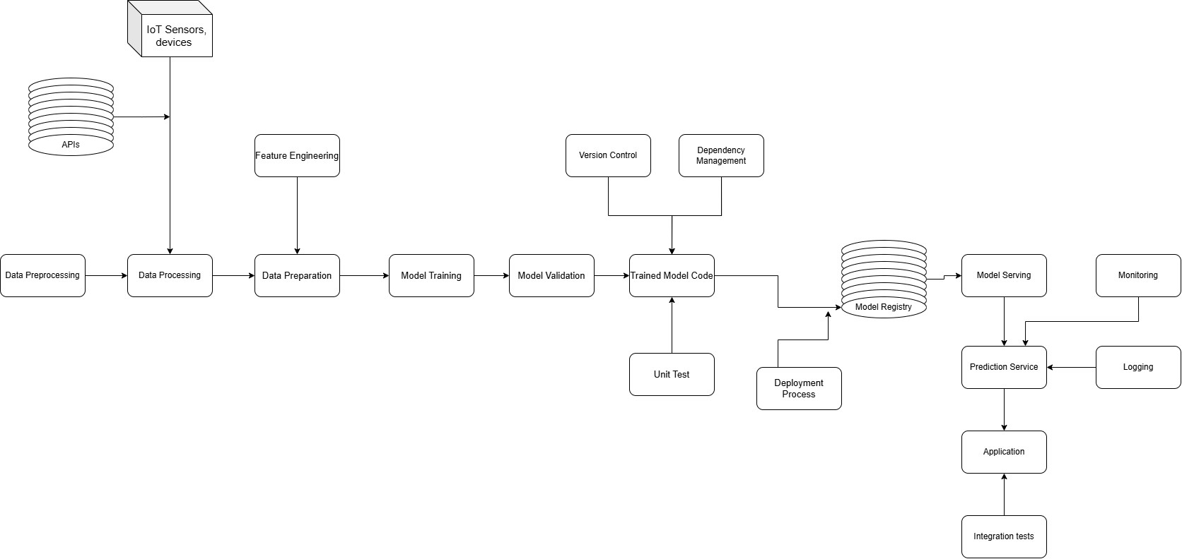
UML Diagrams
Figure: Working Flow of Proposed system

Slide 17
Contd……
This is an behavioral diagram that illustrates the flow of control or data through a IoT sensors and devices collect real-time data through APIs. The data undergoes preprocessing, including cleaning and filtering, followed by processing for transformation and aggregation. Feature engineering is applied to extract relevant attributes, and data preparation ensures readiness for model training. The machine learning model is trained and validated using cross-validation and hyperparameter tuning. Trained model code is managed through version control and dependency management, with unit testing ensuring reliability. The model is registered and deployed through a structured pipeline. Model serving enables real-time predictions via APIs, with logging and monitoring ensuring performance tracking. Integration tests validate the final application before deployment.

Slide 18
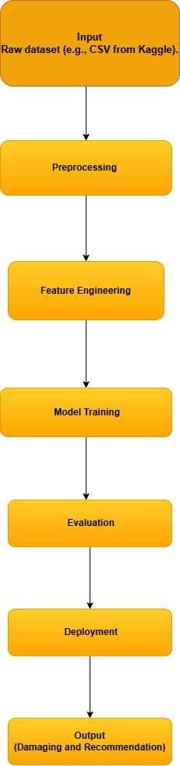
Data Flow Diagram
A Data Flow Diagram (DFD) is a traditional way to
visualize the information flows within a system.
A neat and clear DFD can depict a good amount
of the system requirements graphically. It can be
manual, automated, or a combination of both.
It shows how information enters and leaves the
system, what changes the information and where
information is stored. The purpose of a DFD is to show
the scope and boundaries of a system as a whole.
It may be used as a communications tool between a
systems analyst and any person who plays a part in the
system that acts as the starting point for redesigning a system.

Slide 19
Cont…
Class Diagram:
Represents the system’s structure, including key components and relationships.
Classes: Aircraft, Sensor, DataProcessor, MLModel, MaintenanceReport
Relationships: Aircraft has Sensors, DataProcessor processes Sensor Data, model predicts Failures

Slide 20
Cont…
Sequence Diagram:
Shows the interaction flow between components for predictive maintenance.
Steps: Sensor sends data → Data Processor cleans data → ML Model predicts failure → Alert sent to Engineer

Slide 21
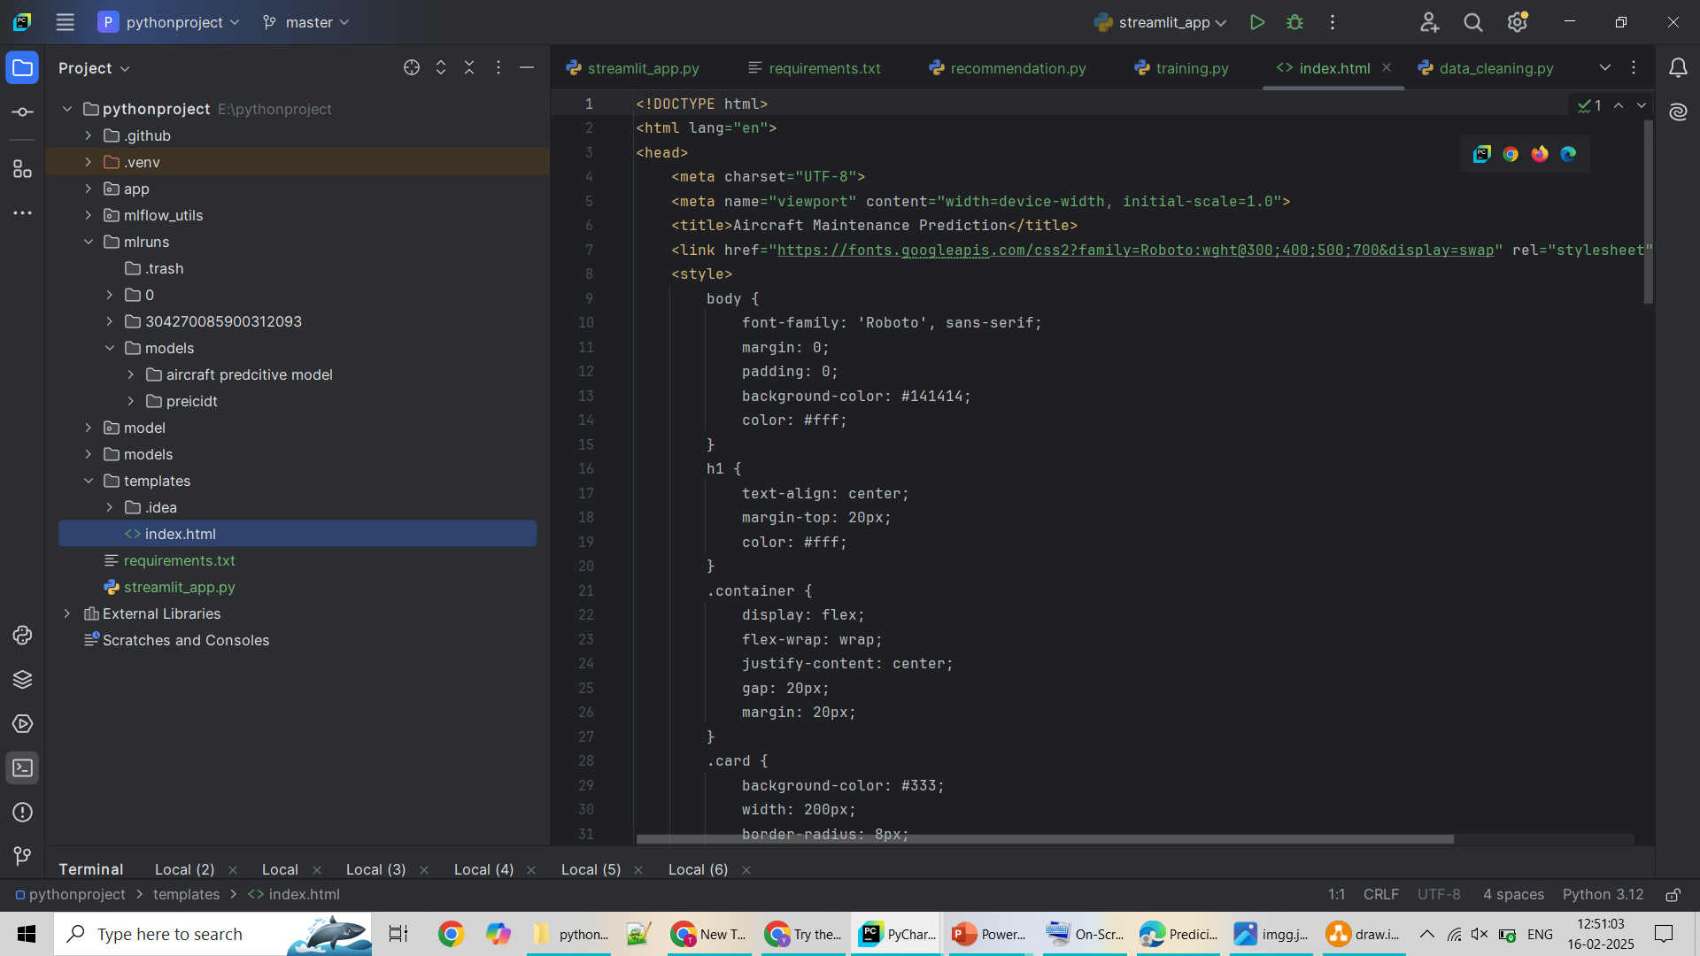
Sample Code
For FrontEnd Application

Slide 22
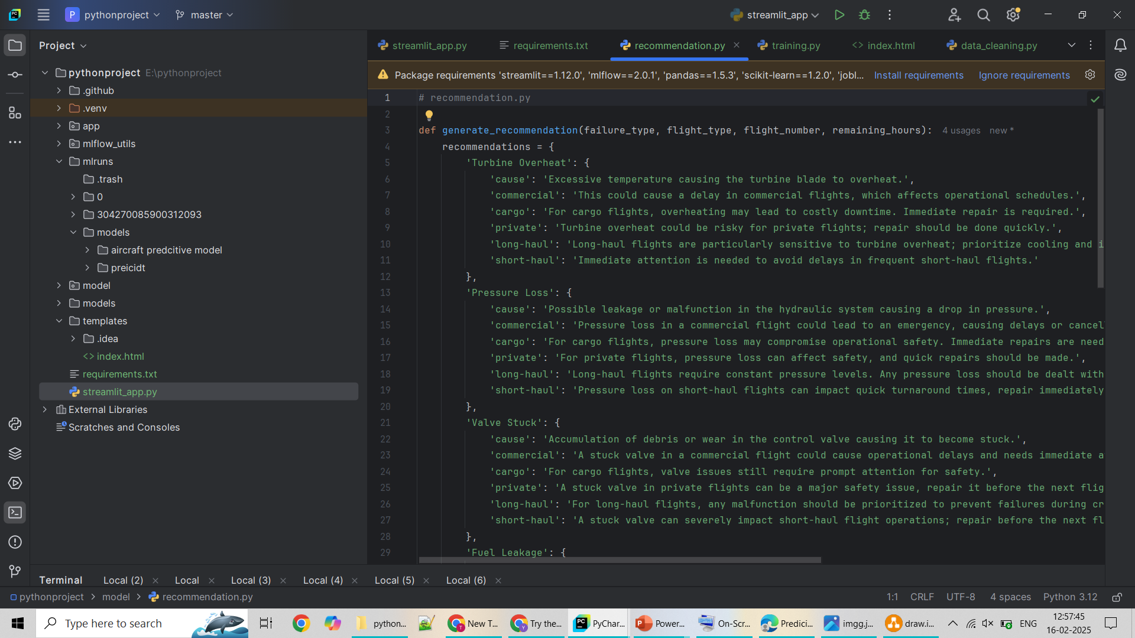
Sample Code
For Recommendations:

Slide 23
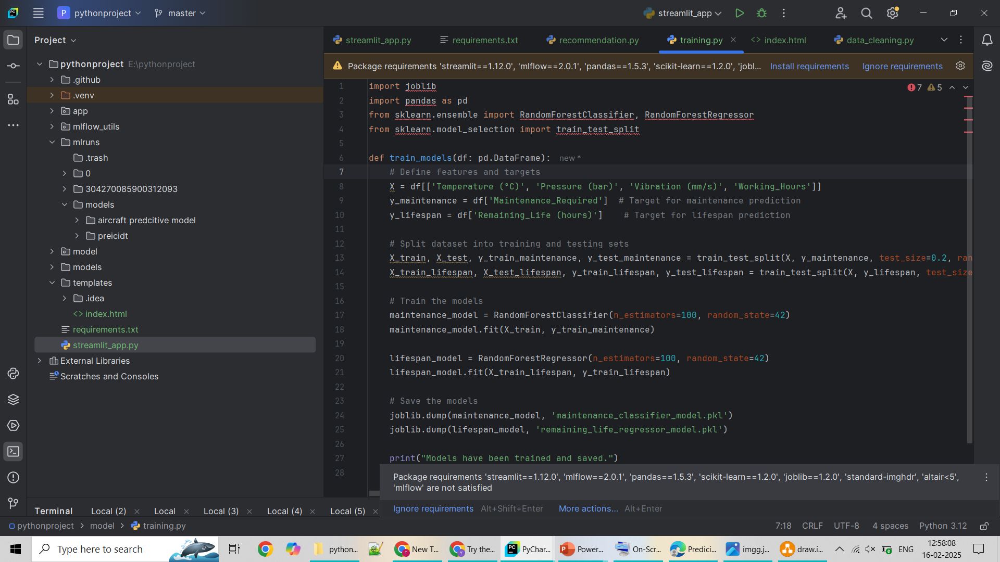
Sample Code
For Training:

Slide 24
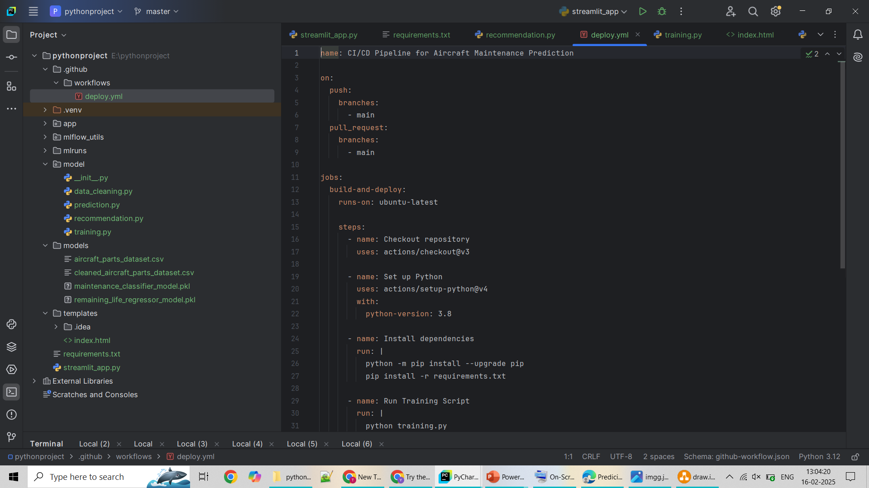
Sample Code
For Github Running:

Slide 25
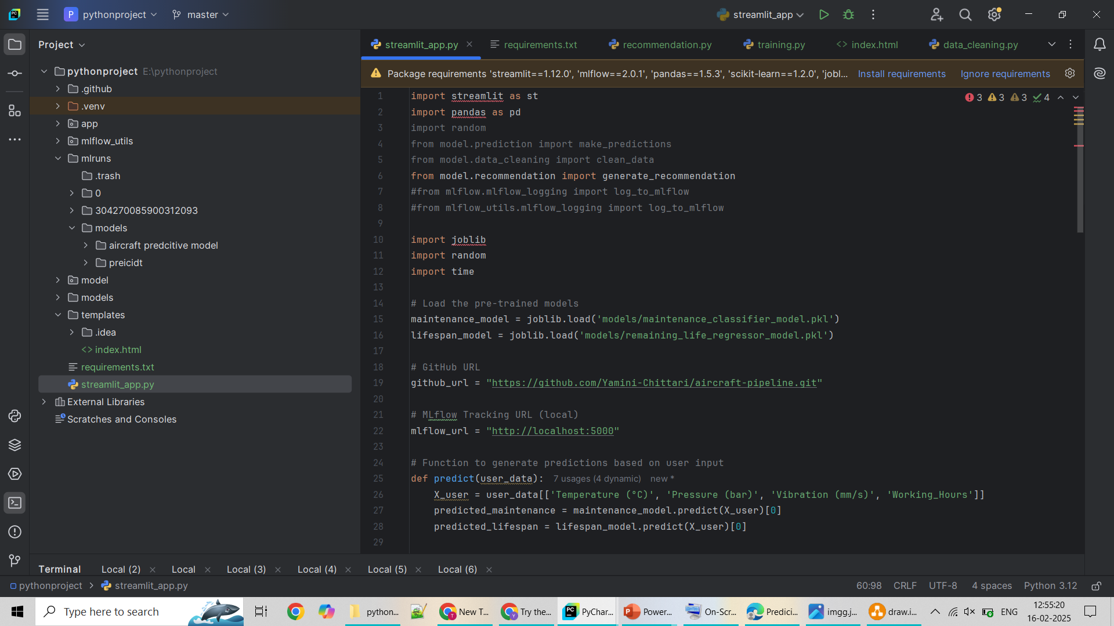
Sample Code
MainCode:

Slide 26
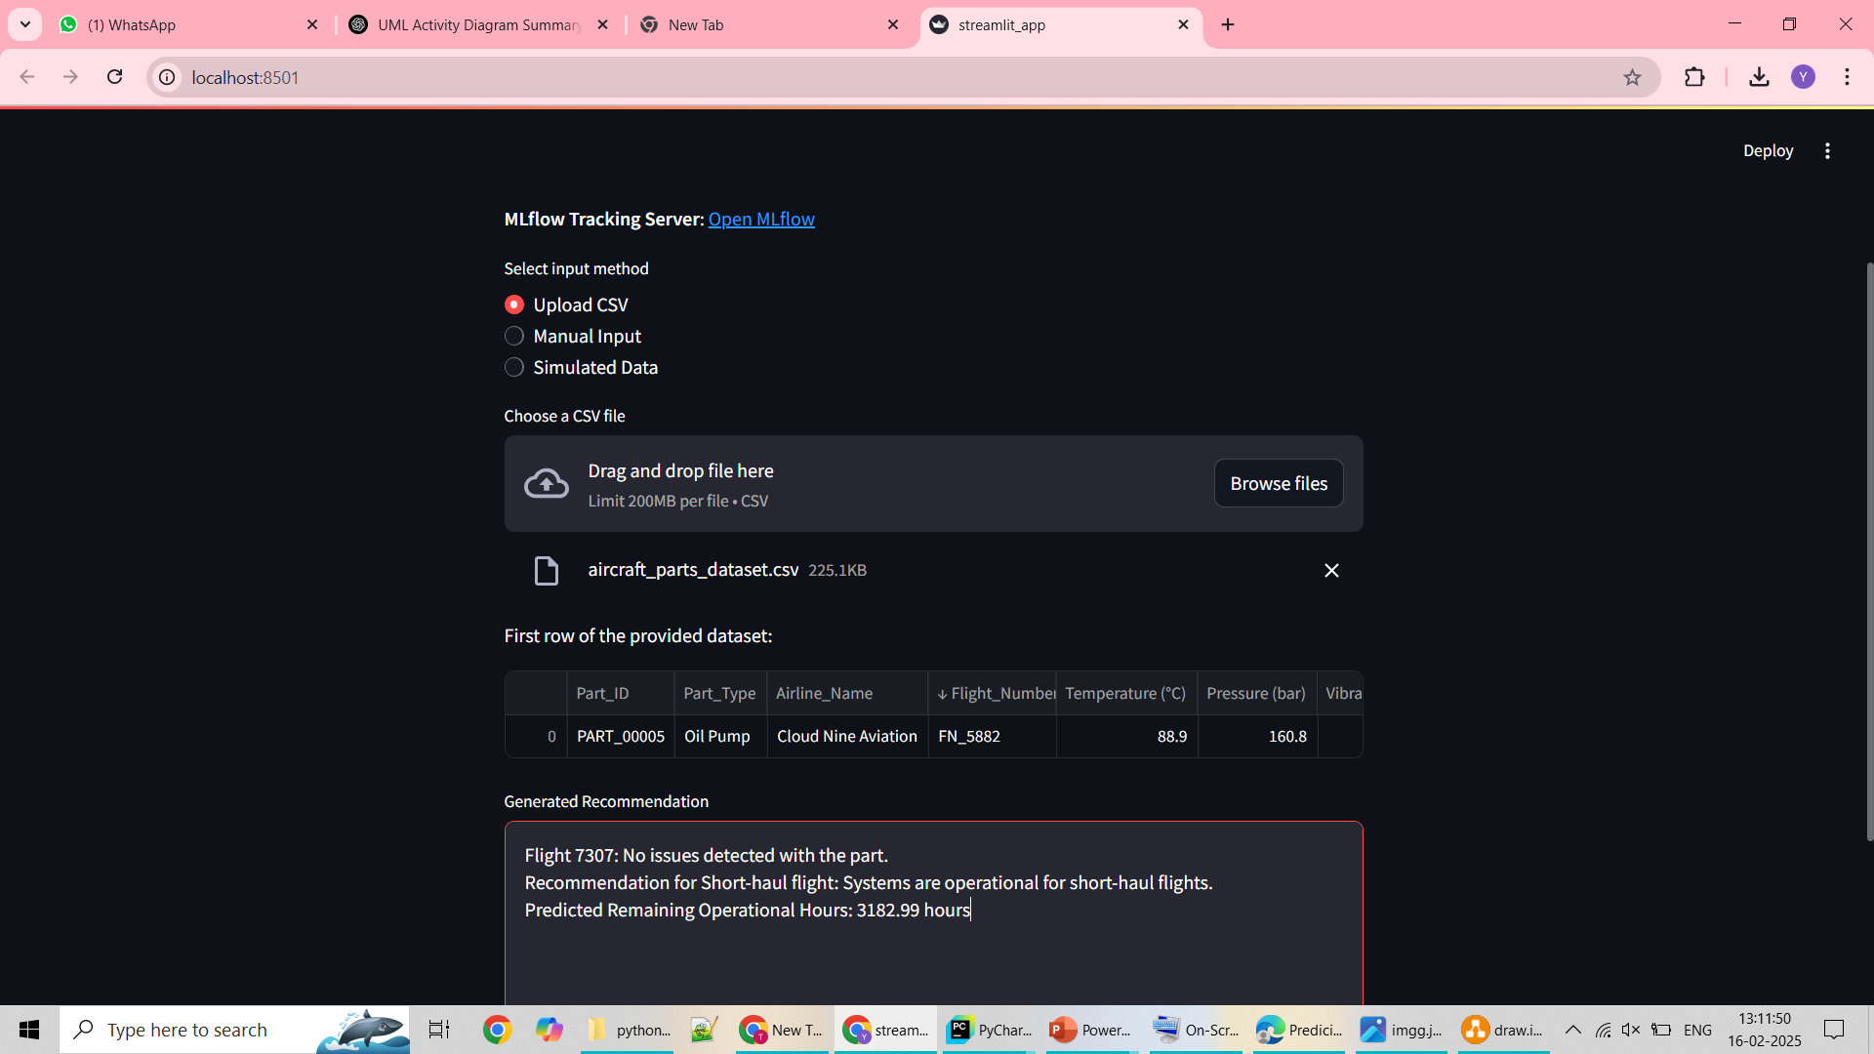
Project Output:

Slide 27
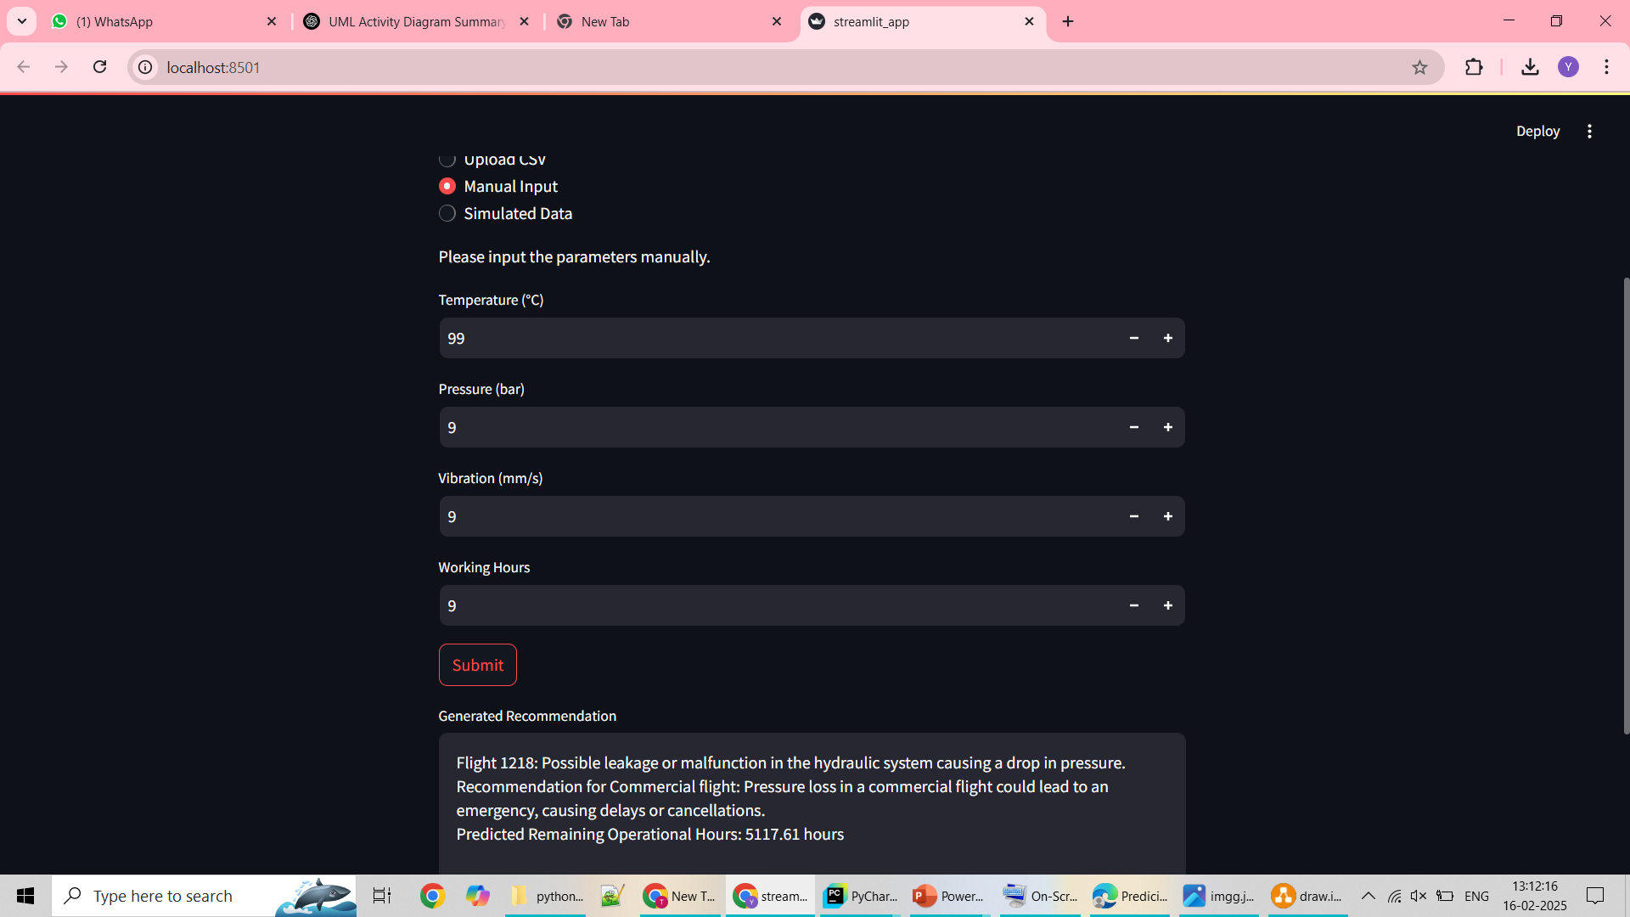
Contd….

Slide 28
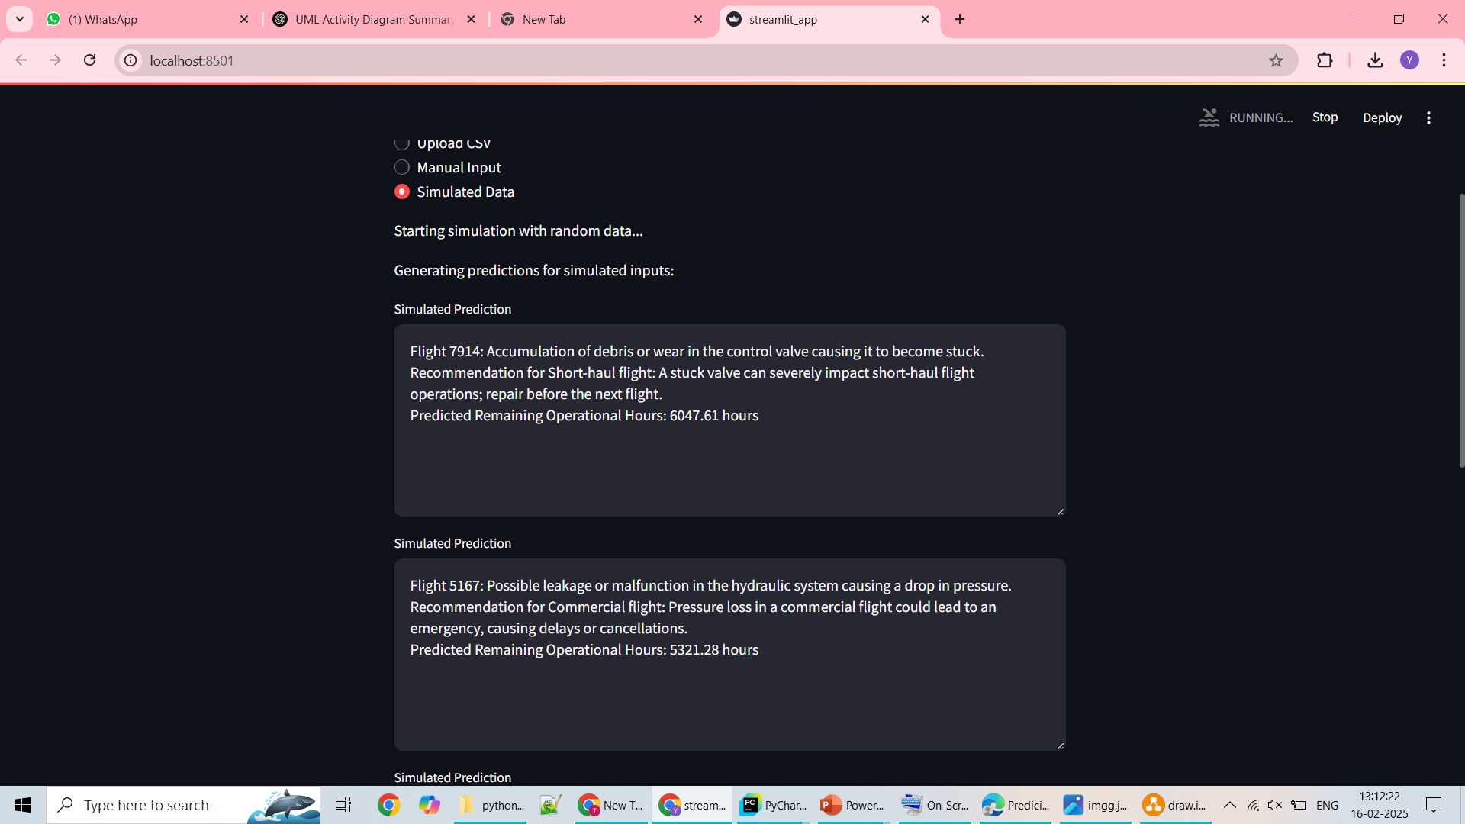
Contd…

Slide 29
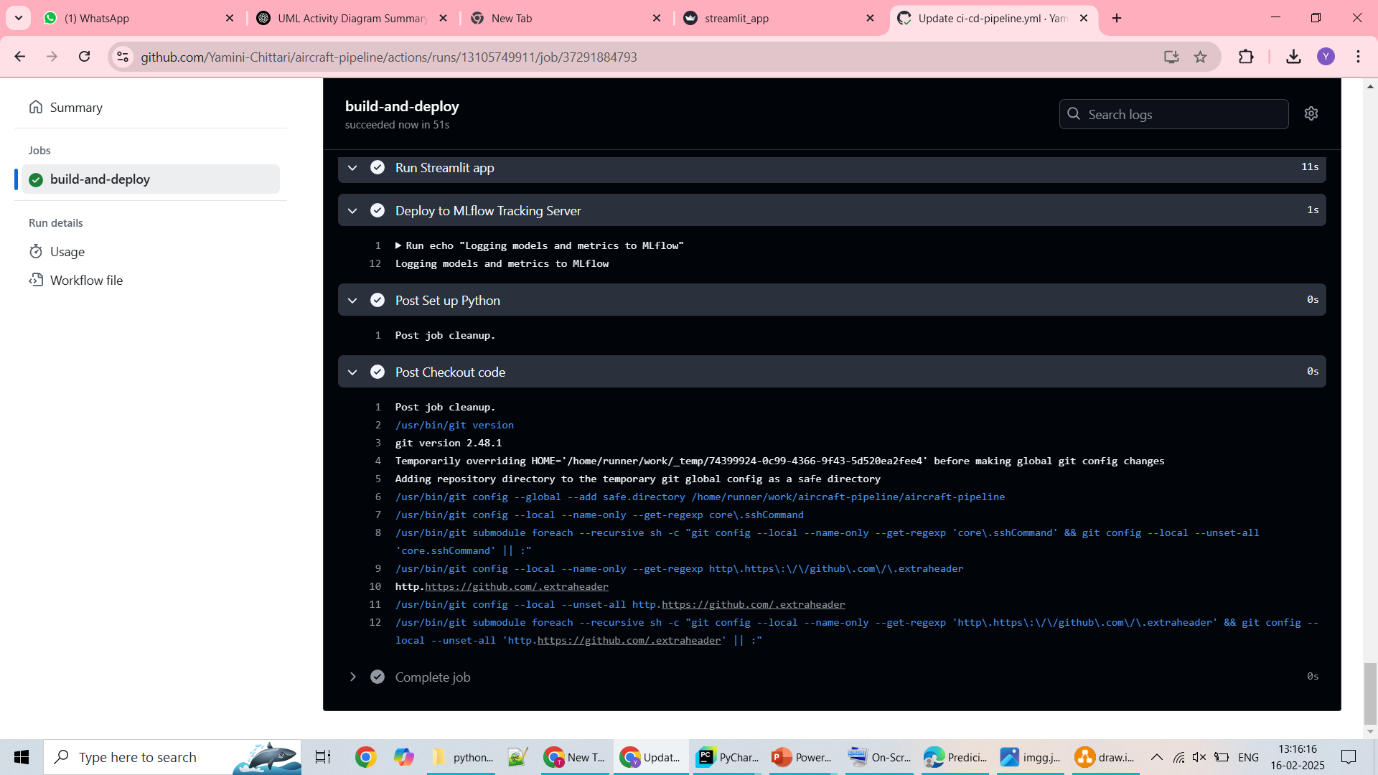
Contd….

Slide 30
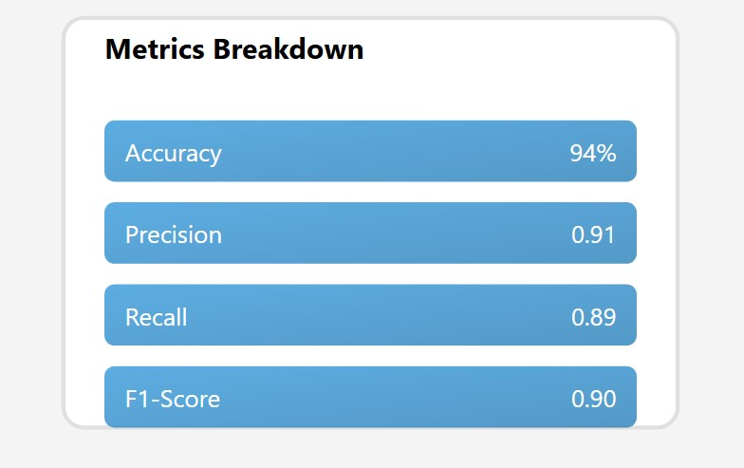
Results and Analysis
Model Performance:
The Random Forest classifier achieved 94% accuracy, making it the most reliable model for predicting failures. Key observations include:
Precision (0.91 for failure):
Indicates a low false positive rate.
Recall (0.89 for failures): Ensures most failure events are correctly captured.
F1-Score (0.90 for failures): Balances precision and recall, making the model
highly effective.

Slide 31
References
[1]. Jardine, A. K., Lin, D., & Banjevic, D. (2006). A review on machinery diagnostics and prognostics implementing condition-based maintenance. *Mechanical Systems and Signal Processing*, 20(7), 1483-1510.
[2]. Malhotra, R., & Khanna, M. (2015). A systematic review of machine learning techniques for software fault prediction. *Applied Soft Computing*, 27, 504-518.
[3]. Zhang, X., & Wang, Y. (2019). Predictive maintenance for aircraft engines using LSTM networks. *Journal of Aerospace Engineering*, 32(4), 04019045.
[4]. Breiman, L. (2001). Random forests. *Machine Learning*, 45(1), 5-32.
[5]. Scikit-learn: Machine Learning in Python. (2020). Retrieved from https://scikitlearn.org/stable/
[6]. Streamlit: The fastest way to build and share data apps. (2020). Retrieved from https://streamlit.io/
[7]. MLflow: A Machine Learning Lifecycle Platform. (2020). Retrieved from https://mlflow.org/

Slide 32
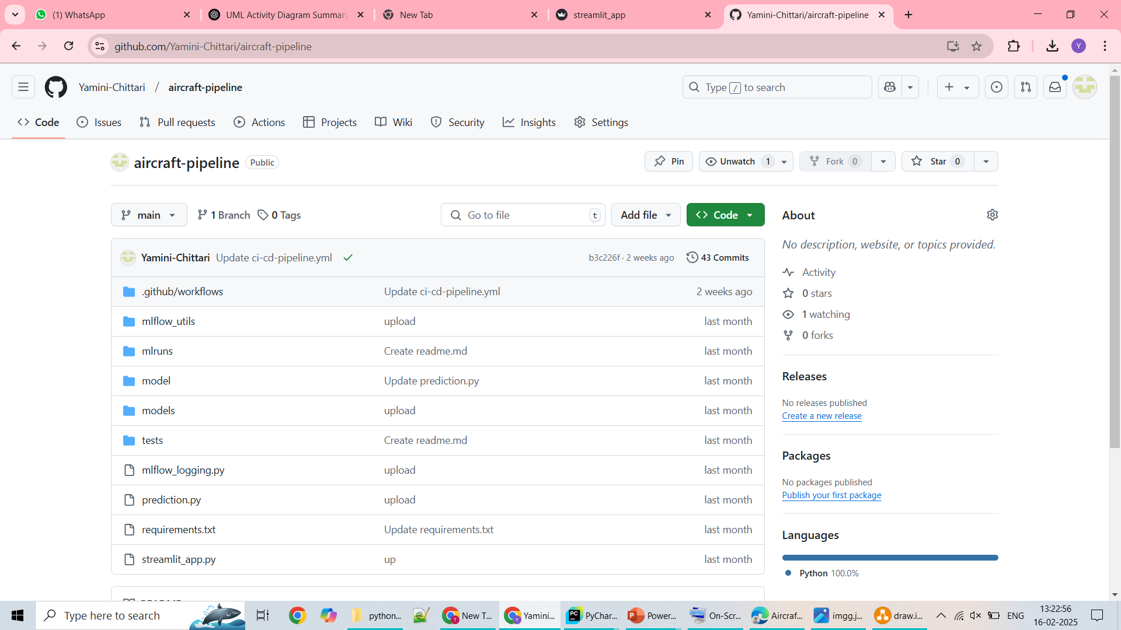
Git Hub Dashboards of each student

Slide 33
Any Queries?

Slide 34
Thank You!!!

